Slide 1
CORE WP5 Partners Meeting - Local Partners Follow-up -
Teams
19 January 2024

Slide 2
Agenda
Where we stand
Work plans and budget validated
COBATEST Toll – “up & running”
Implementation Phase
Monitor the implementation
Documents Share & dates
Local partners feedback
Sharing achievements, challenges and ways forward
Follow-up

Slide 3
M13 M36
Implementation phase:
- start work plans implementation
- Updated Cobatest tool ready to use
M18
D5.2 - Peer Program Manual
EC mid-term report
M36
ML14 – Activity report completed
D5.3 - Implementation results final report
Jan 2024
Jun 2024
Dec 2025

Slide 4
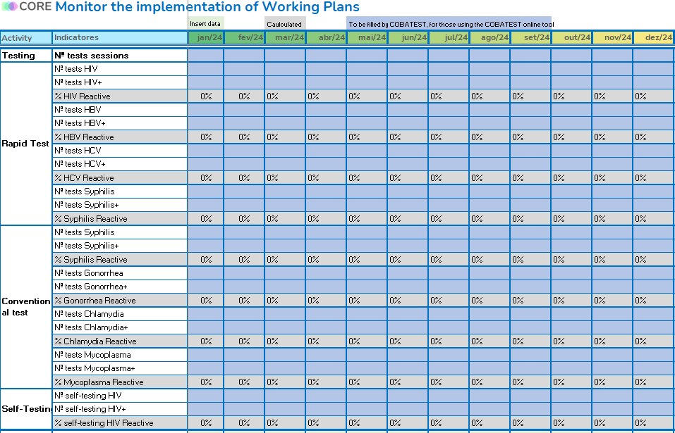

Slide 5
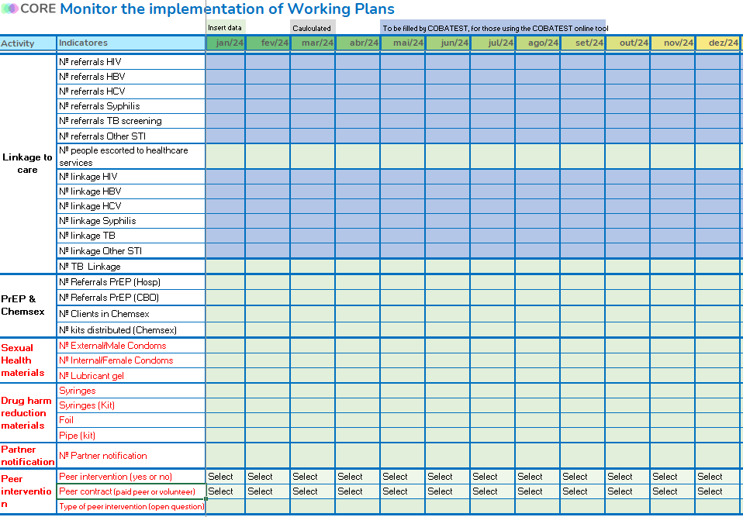

Slide 6
Follow-up: meetings and reporting dates
DATE | Meeting LINK
19th Jan 10 am (Lisbon time) | Click here to join the meeting
15st March 10 am (Lisbon time) | Click here to join the meeting
17th May 10 am (Lisbon time) | Click here to join the meeting
19th July 10 am (Lisbon time) | Click here to join the meeting
20th September (Lisbon time) | Click here to join the meeting
15th November (Lisbon time) | Click here to join the meeting
Form: data 1 Jan- 29 Feb
Form: data 1 Jan- 30 Apr
Form: data 1 Jan- 30 Jun
Form: data 1 Jan- 31 Aug
Form: data 1 Jan- 31 Oct
*January 2025 – data 1st year of implementation (Jan 24-Dez 24)

Slide 7
Thank You!
CORE WP5 Team

